Slide 1
AWS DevOps INTERNSHIP MINI PROJECT – 1
By MUJAHID SHAIK

Slide 2
LABS :
IAM HANDS ON
BILLING ALARM
S3 BUCKET
ELASTIC COMPUTE CLOUD [EC2] INSTANCE
SECURITY GROUP
VOLUMES AND SNAPSHOTS
AMAZON MACHINE IMAGE [AMI]
LOAD BALANCER
AUTO SCALING GROUP AND LAUNCH CONFIGURATION
RELATIONAL DATABASE SERVICE

Slide 3
LAB – 1 [IAM HANDS ON]
TASKS TO DO :
Setup MFA for Root User.
Create a User with console access.
Assign only EC2 full permissions.
Check if the user can explore other services.
Provide Administrative privileges to the user.

Slide 4
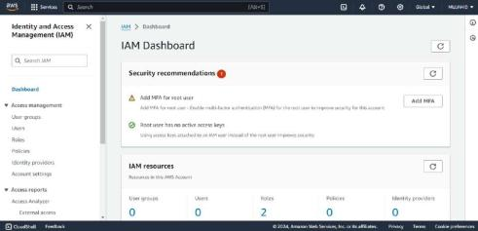
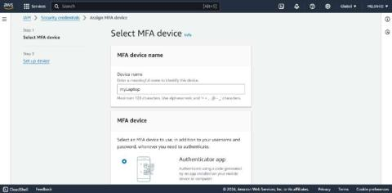
I logged in with my AWS credentials and Entered into my IAM service.
In the IAM dashboard click on Add MFA.
Add a device name
Download Authenticator App on your mobile.
Enter two codes and now MFA is successfully added to the Root User.

Slide 5
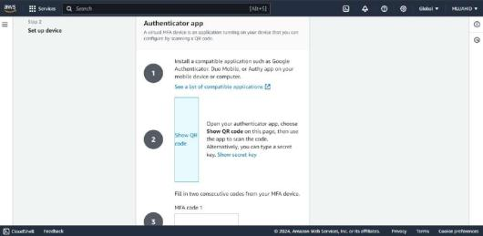
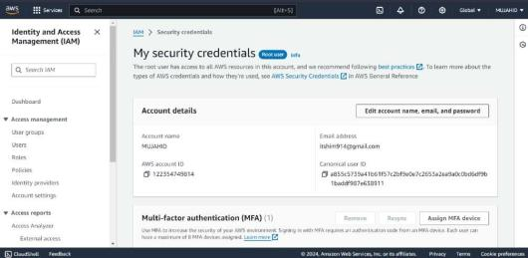

Slide 6
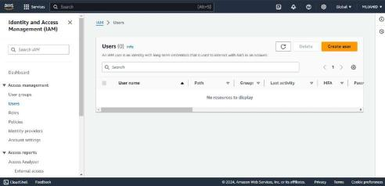
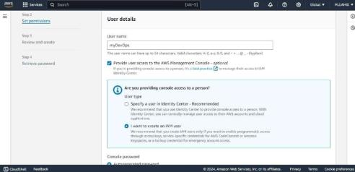
Click on create user.
Give User a name and give user console access.
Create a password either Auto generated or your own.

Slide 7
Check if the user has permission to explore EC2 service. Obviously they do not.
Log back as Root user and give EC2 full permission to the user.
Log back as IAM user and check now if the user can Explore EC2 service. They do.
Check if the user can explore other services than EC2.

Slide 8
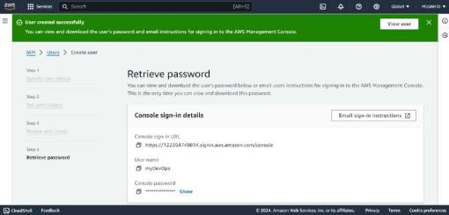
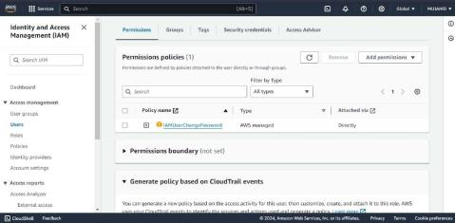
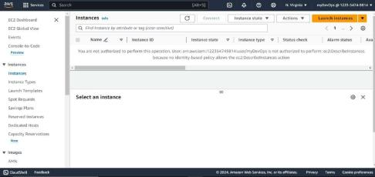
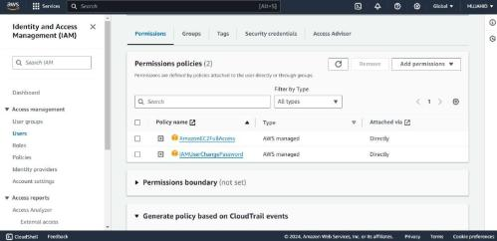

Slide 9
Later Give Full Administration access to the user and check if the user can Explore all the services on AWS.
They do.

Slide 10
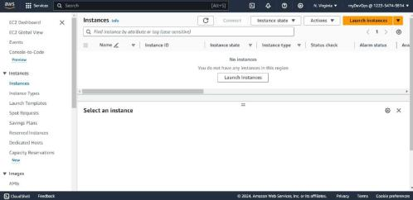
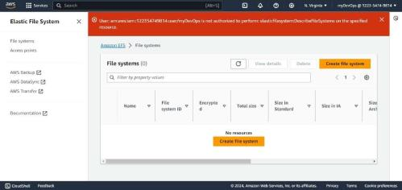
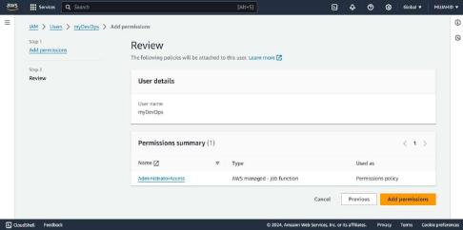

Slide 11
LAB – 2 [BILLING ALARM]
TASKS TO DO :
Setup a Billing Alarm and for your AWS Account to get a Notification whenever the account crosses the Billing threshold.

Slide 12
Login to AWS Management console.
Open Cloud watch service, click on Alarms and then click on Billing.
Click on create Billing Alarm and set a Name to the Alarm in the specifying Metric and Conditions.
In the conditions select the threshold and the value.

Slide 13
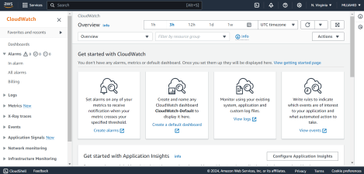
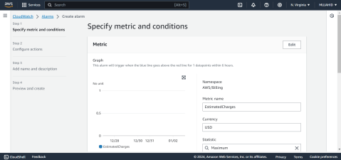
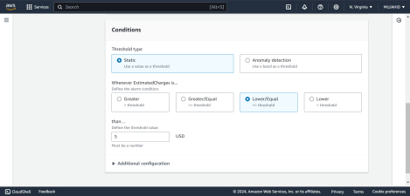
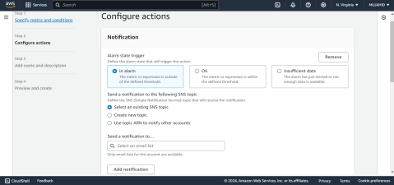

Slide 14
In the next step select the Notification type and create a SNS topic if not already created and select the email to which Notification is to be sent.
Review all the Conditions and click on create Alarm.

Slide 15
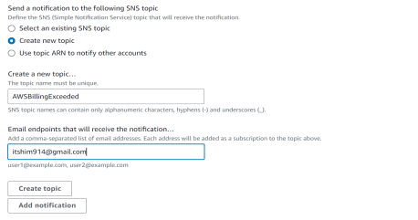
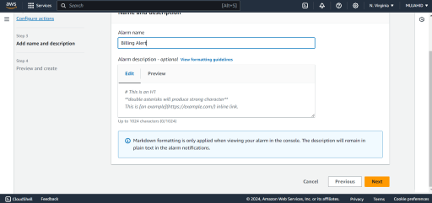
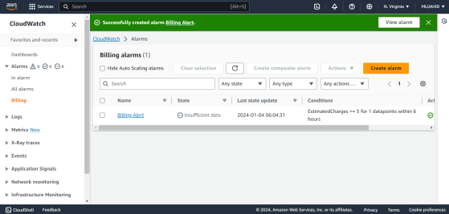

Slide 16
LAB – 3 [S3 BUCKET]
TASKS TO DO :
STEP - 1
Create a S3 Bucket.
Upload some content.
Make the content public and access it through browser.
STEP – 2
Enable Versioning
STEP – 3
Deleting and recovering Content using Versioning

Slide 17
STEP - 1
Login to AWS management console and open S3 Bucket service.
Click on Create S3 Bucket.
Select general purpose and Give a Unique name to your S3 Bucket.
Disable object ownership and Block all public access to the bucket.
Disable bucket versioning for later step and click on create bucket.

Slide 18
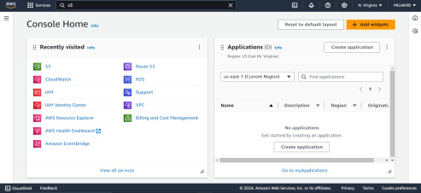
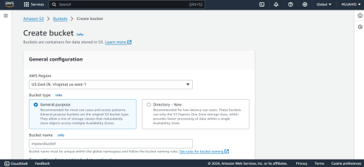
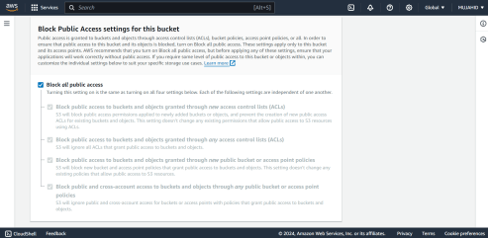
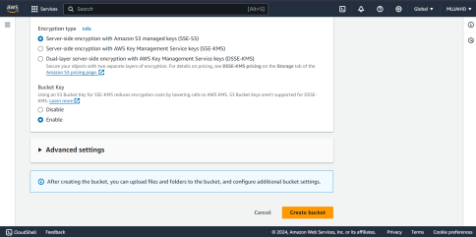

Slide 19
Upload some files from your Local PC.
Choose the storage class as Standard and try to access the content with its end point link through browser.

Slide 20
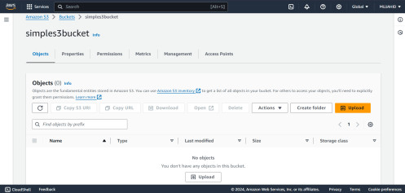
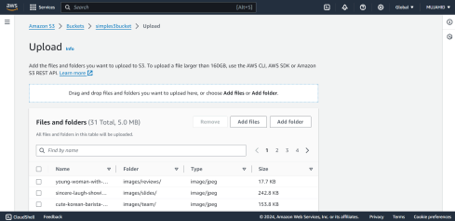
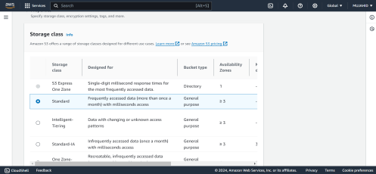
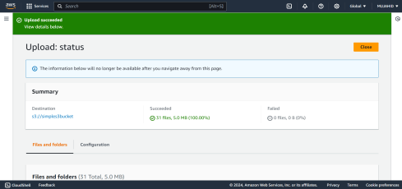

Slide 21
You cannot, cause the bucket ownership is disabled and the content in the bucket is public.
Open the bucket and click on permissions tab uncheck where it says block all public access and click on save changes.

Slide 22
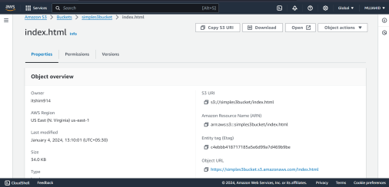
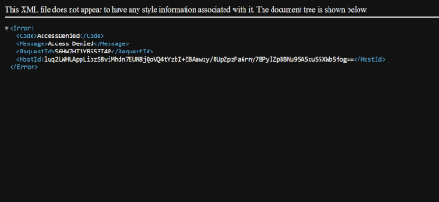
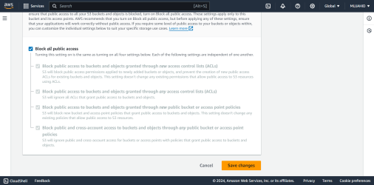
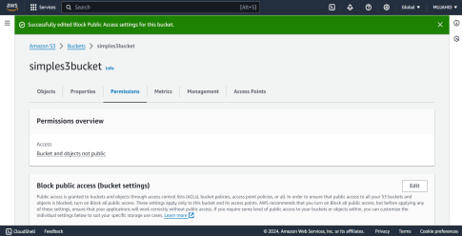

Slide 23
And then Enable object ownership and then make all the objects in the bucket public.
Now try to access the content in the bucket through browser and it should be accessible.

Slide 24
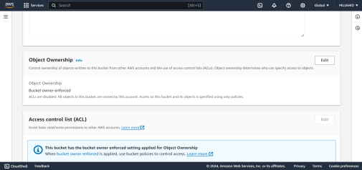
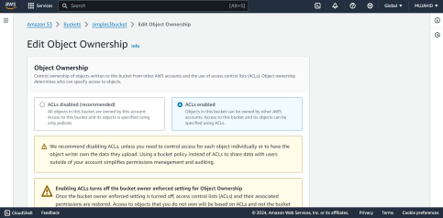
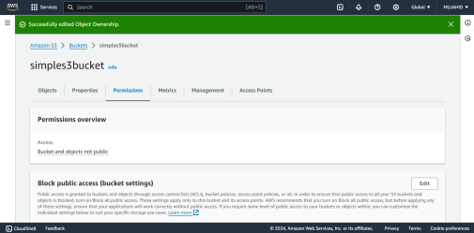
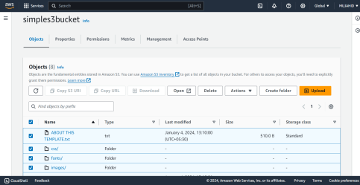

Slide 25
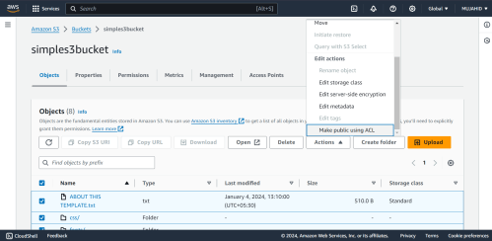
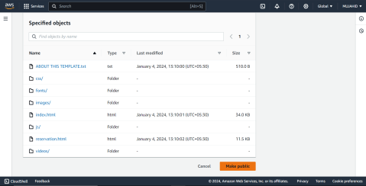
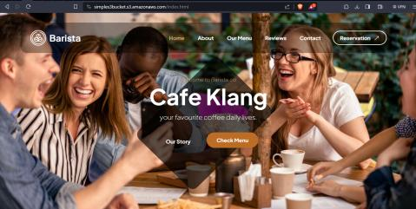

Slide 26
STEP – 2
Click on the bucket you created and go into properties tab.
Enable versioning and save changes.

Slide 27
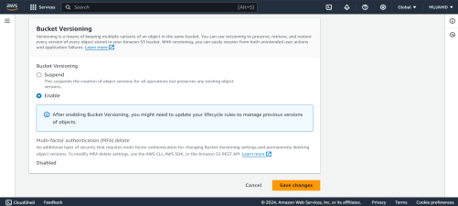
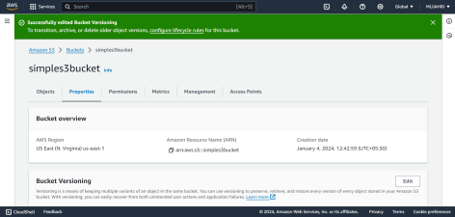
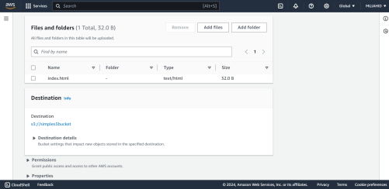
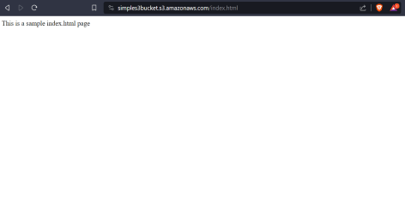

Slide 28
STEP – 3
Upload some new file and check the content of it in browser.
Delete the file and recover it again using Versioning.

Slide 29
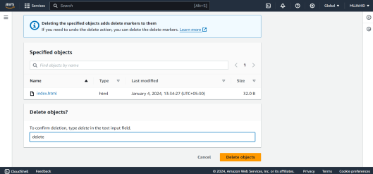
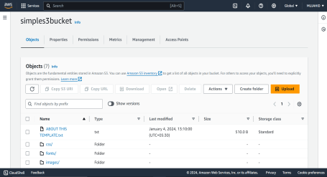
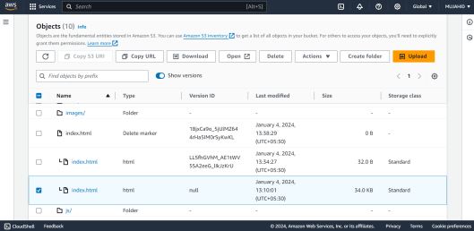
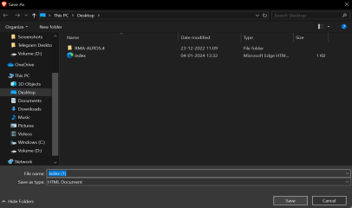

Slide 30
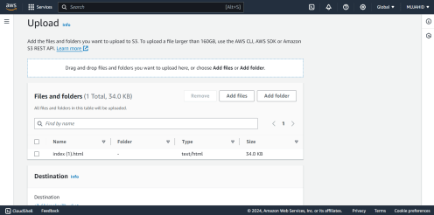
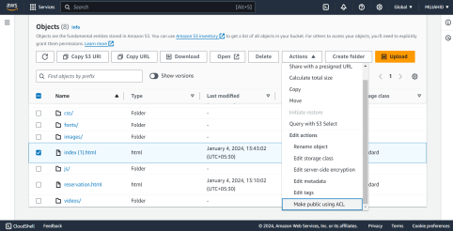
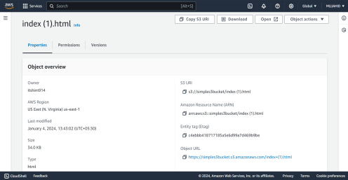


Slide 31
LAB – 4 [EC2 INSTANCE]
TASKS TO DO :
Launch an EC2 Instance if type t2micro with Ubuntu free tier OS.
Allow the required port to access the Instance from outside.
Access the Instance from your local machine using Putty/other SSH software.

Slide 32
Login to AWS Management console.
Open EC2 service and click on launch EC2 Instance.
Give a name to your Instance.
Select the Ubuntu 20.04 free tier OS in the AMI section.
Select the Instance type as t2micro.
Create a key pair and select the key format as .ppk and save it in your local machine to access the Instance.

Slide 33





Slide 34
In the Networking section Allow SSH [port 22] from My IP to login to the Instance.
Review all the configurations you made and click on Launch Instance.
Download and install Putty software from Internet.
Open Putty and paste the Public IP of your Instance in the Host Name and give the session a name and save it.
In the "Connection" category Expand "SSH" and select "Auth" and select “Credentials”. Browse and select the PPK file you generated while creating instance and click "Open" to start the SSH session.
When the shell is opened give your AMIs Username to Login.

Slide 35






Slide 36
LAB – 5 [SECURITY GROUP]
TASKS TO DO :
Create a new Security Group SG.
Check the rules of default Security Group.
Allow port 80 and 22 Inbound rules from your IP.
Attach the new Security Group to your existing EC2 Instance.

Slide 37
Login to AWS Management console.
Open EC2 dashboard and click on Security Groups.
Click on create a new Security Group.
Give your Security Group a name and a description.
Select the default VPC or your configured one.
In the Inbound rules section Allow port 22 allowed form My IP and port 80 allowed from anywhere and then click on create Security Group.

Slide 38





Slide 39
To change the Security Group of existing Instance.
Select the existing EC2 Instance and click on actions, security and then click on change Security Group.
Select the Security Group SG that you’ve just created and click on save.

Slide 40





Slide 41
LAB – 6 [VOLUMES AND SNAPSHOTS]
TASKS TO DO :
Create a 5GB volume and attach it with running EC2 Instance and put some content in it.
Increase the size of this volume to 8GB and check.
Take a Snapshot of the volume and delete the volume.
Create a new volume with the Snapshot & attach it to the server just like step 1

Slide 42
Login to AWS Management console.
Open EC2 dashboard and click on Volumes and the click on Create volume.
Select the volume type as General Purpose SSD [gp3] and set the size to 5GB.
Check the availability zone of the volume, keep it in the same availability zone as in which the EC2 instance is and click on create Volume.
After the volume is created select it and click on Actions and then click on Attach volume.
In the configuration box select the Instance to which you want to Attach it.
After doing so, Click on attach volume. Check the attached volume in the Instance’s storage section.

Slide 43





Slide 44
Now to access it Login to Instance and create a directory to attach the volume.
Create a file system with your block volume.
Then Mount the volume to the directory you created and put some content in it.

Slide 45






Slide 46
To Increase the size of the volume, Select the volume and click on Actions and then click on Modify Volume. Then Increase the size from 5GB to 8GB and click on Modify.
Size of the file system to associate with the block volume also need to be increased.
Resize the file system using command [ sudo resize2fs /dev/xvdf ] .

Slide 47






Slide 48
To take a snapshot of this volume select the volume, click on Action and then click on create Snapshot.
Give a description and Tag and click on Create Snapshot.
To delete the volume, first force detach it from the Instance and then Delete it.

Slide 49





Slide 50
Now select the snapshot and click on Actions and then click on Create a Volume from Snapshot, leave everything as it is and click on create Volume.
In the volumes section select the volume and attach it to the existing Instance just like in the first step.

Slide 51








Slide 52
LAB – 7 [AMAZON MACHINE IMAGE]
TASKS TO DO :
Create an AMI of your Running EC2 Instance.

Slide 53
Select the running EC2 Instance and click on Actions > Images and Templates > Create Image.
Give a Name and a Description to the AMI.
Click on Create AMI.

Slide 54




Slide 55
LAB – 8 [LOAD BALANCER]
TASKS TO DO :
Create two EC2 Instances, Start and Install NGINX & HTTPD on each.
Access both Instances over browser.
Create one Load Balancer and Attach both the Instances to the LB.
Allow only port 80 in LBs Security Group & also make sure the SG of your Instance receives request from LB only on port 80.
Access the Load Balancer DNS over the browser and hit refresh couple of times.
Check if the both web pages are shuffling.

Slide 56
Create two Security Groups, one for Instances and One for Load Balancer.
First create a SG for LB with Inbound rule port 80 allowed from anywhere.
Create a SG for Instances with Inbound rules port 22 allowed from My IP to Login to the Instances and port 80 allowed from LBs Security Group.

Slide 57





Slide 58
Now create two Instances with Ubuntu 20.04 free tier OS just like we did in Lab 4 and make sure to attach the SG created for Instances.
Create a Target Group for instances with desired healthy and unhealthy thresholds.

Slide 59





Slide 60
Select IPv4 address type.
Add healthy and Unhealthy thresholds as 2.
Add the instances that we created for Load Balancer in the Target Group.
Check the configurations you made and click on create Target Group.

Slide 61





Slide 62
Then create an Application Load Balancer with default VPC.
Select more than 2 Availability zones for High availability.
Make sure to attach the SG created for LB in the first place.
In the listeners and routing set port 80 forward to Target Group.
Check all the configurations you made and click on create Load Balancer.

Slide 63





Slide 64
Connect to the instances and Install, Start and Enable NGINX and HTTPD on each Instance. Host a static web Application on each Instance.
Browse the LBs DNS link in the browser and hit refresh a few times.
You’ll see the web applications shuffling.

Slide 65





Slide 66
LAB – 9 [ASG & LC]
TASKS TO DO :
Create one Launch Configuration with Ubuntu Server.
Create an Auto Scaling Group and attach above created Launch Configuration with it.
Keep the size of the Instances as Minimum 1 & Maximum 3.
Try to change the Max capacity and check the new Instances getting created.

Slide 67
Creating a Launch Template is similar to creating an Instance.
Click on create Launch template and configure everything just like an Instance and click on create Launch Template.

Slide 68





Slide 69
Now create a Auto Scaling Group with the above created Launch Template.
Give a name to the ASG and select the above created LT, in the Network select all the AZs for Instances to be created in it.
In the Group size set the limits as Min 1 & Max 3 and Desired as 2.
You can also Add Notification alert whenever a new Instance is created.
Check all the configurations you made and click on create ASG.

Slide 70





Slide 71
Check the EC2 dashboard after few minutes, we see Instance getting created as per our desired capacity that we set in ASG.
Modify the ASG, change the Max capacity from 3 to 4 and check the Instances getting created.

Slide 72





Slide 73


Slide 74
LAB – 10 [RDS]
TASKS TO DO :
Provision a RDS Instance.
Open MySQL port in connected Security Group.
Access the RDS from your EC2 Instance.

Slide 75
Launch an Instance just like we did in LAB 4 allowing only port 22 from My IP to Login to the Instance.
Search for RDS in services search bar and click on create Database.
Select Standard type and MySQL Engine.
Select free tier template.

Slide 76





Slide 77
Create Authentication for accessing database with username and password.
Select general purpose SSD which gives 20GB of free tier Storage.
In the connectivity option attach the Instance that we created for database.
Create a new VPC SG and check all the configurations you made and click on create database.
Wait for sometime for the database creation. Open the SG that you created for RDS database and Add an Inbound rule allowing port 3306 from My IP.

Slide 78





Slide 79
Connect to the Instance and Install MySQL service.
After the database is created access it using command
[mysql -h <RDS_ENDPOINT> -u <USERNAME> -p]
Here <RDS_ENDPOINT> refers to the endpoint provided by your RDS database.
<USERNAME> refers to the username you created while provisioning RDS database.
Enter the password in the password section and clicking Upon Enter you will be directed to your MySQL Database.

Slide 80





Slide 81
THANK YOU

